Slide 1

SAS Predictive Analytics-Titanic Survivors By Joshua Troup

Slide 2
What is SAS?
SAS = Statistical Analysis System
Business Intelligence tool used for multiple advanced analytics, multivariate analyses, business intelligence, data management, and predictive analytics.
The ability to analyze your data using statistical techniques ranging from descriptive measures like correlations to logistic regression and mixed models to sophisticated methods such as modern model selection and Bayesian hierarchical models.
SAS Studio is cloud based and accessible anywhere where a connection and browser is available.

Slide 3
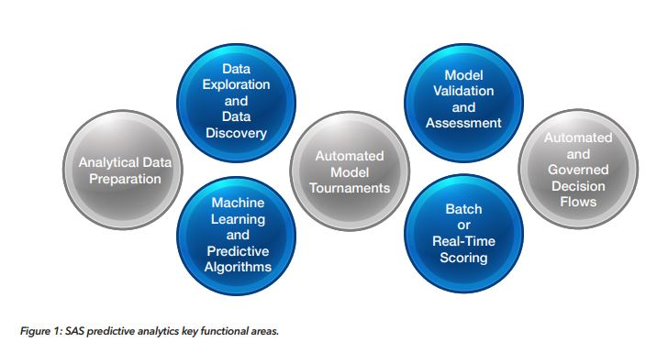
Figure 1 shows the multiple functional areas within SAS predictive analytics. Quantifying uncertainty to drive decisions with the correct method and measure the predictive strength of models using test and validation data sets to gain the most accurate results. The machine learning features built in allow for the user to reuse models, retrain predictive models with new data, and automate decision flows.

Slide 4
Project and Data Selection
Dataset: Titanic.csv
The Royal Mail Ship (RMS) Titanic goes down in history as one of the most infamous shipwrecks which sank after hitting an iceberg to the bottom of the ocean on April 15, 1912. 1,502 people were killed out of the 2,224 passengers and crewmen.
Can I predict passenger survival using a supervised machine learning technique? To meet my goal, I will be using Logistic Regression algorithm. Passengers will be classified using the binary labels: 1 for those who survived and 0 for those who did not.

Slide 5
Variable Chart
Variable | Definition | Key
Survival | Survival | 0 = No, 1 = Yes
Pclass | Ticket class | 1 = 1st, 2 = 2nd, 3 = 3rd
Sex | Sex
Age | Age in years
Sibsp | # of siblings / spouses aboard the Titanic
Parch | # of parents / children aboard the Titanic
Ticket | Ticket number
Fare | Passenger fare
Cabin | Cabin number
Embarked | Port of Embarkation | C = Cherbourg, Q = Queenstown, S = Southampton

Slide 6
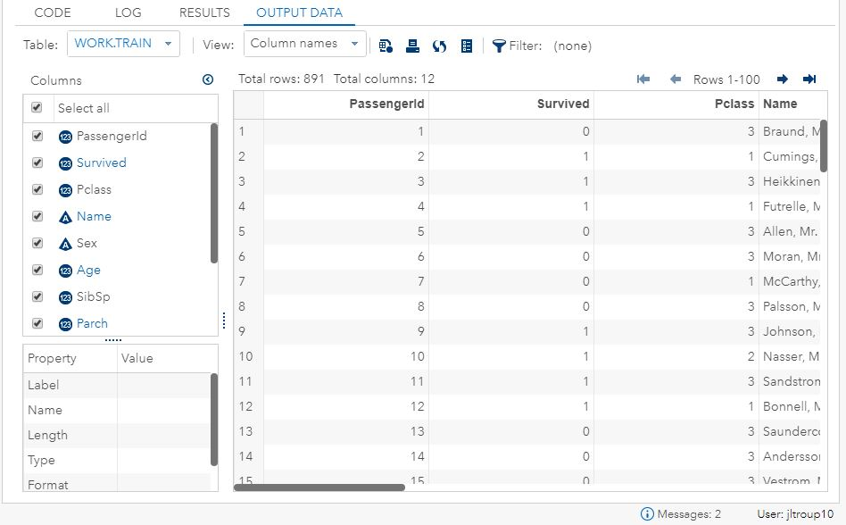
Data Exploration
Unprocessed raw CSV dataset imported into SAS Studio

Slide 7
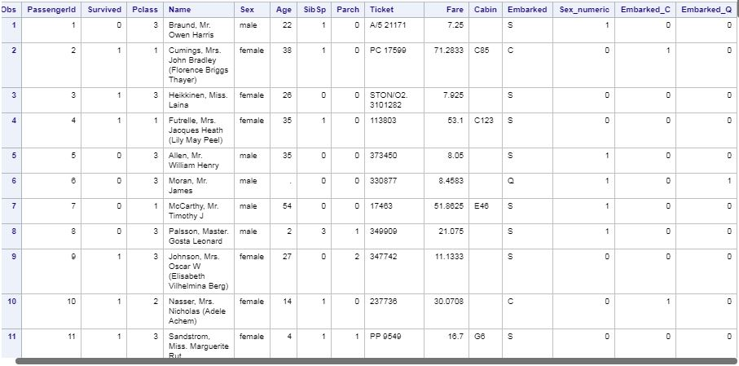
Modifying Data
Dummy variables were created for non-numerical variables Sex and Embarked since they may be relevant in model development

Slide 8
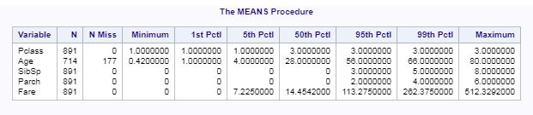
Modifying Data-Missing Values
Missing values are shown above in numerical variables which include Age with 177 null values

Slide 9
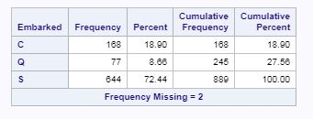
Modifying Data-Missing Values Cont.
Two non-numerical missing values shown above in “Embarked” variable.

Slide 10
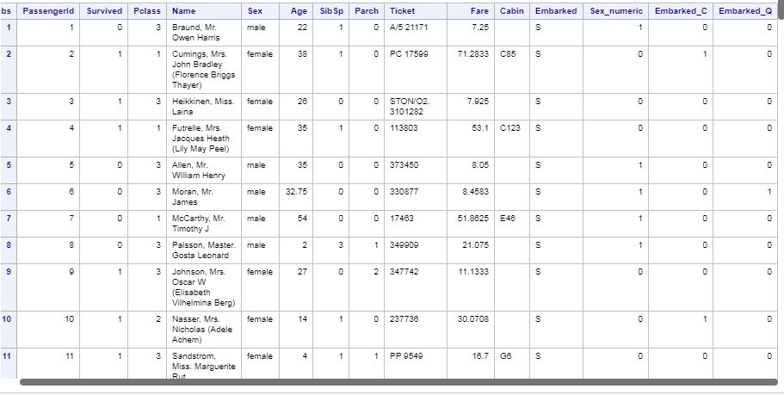
Modifying Data-Missing Values Cont.
Missing values in variable “Age” have been replaced with median value of 32.75. “Embarked” values have been replaced with S.

Slide 11
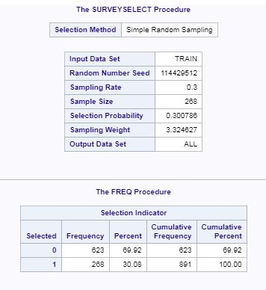
Data Partitioning-70/30
Dataset partitioned at random sampling 70% training/development set and 30% test set.

Slide 12
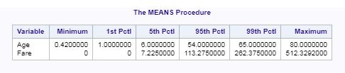
Managing Outliers
Percentiles of “Age” and “Fare” shown above indicate there are no outliers in the dataset.

Slide 13
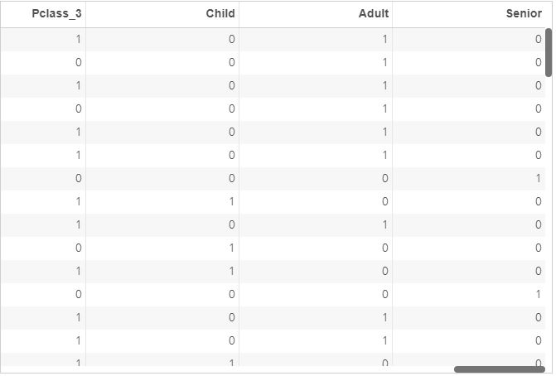
Transformation of Variables
Transformation of “Pclass” and “Age” variables.
Dependent - Survived
Independent – Adult, Age, Child, Embarked_C, Embarked_Q, Fare, Parch, Pclass_1, Pclass_2, Sex_numeric, SibSp
(Note: Senior and Pclass_2 dummy variables not required as other relevant dummy variables are present.)

Slide 14
Machine Learning Algorithm
Logistic Regression: to predict the probability of an outcome knowing the predictors belong to a certain class.
As logistic regression calculates the probability of an event occurring or not, the effect of predictor variables is explained in terms of odds.
Examples: 1.Customer Classification as returning or non-returning
2.Factors that differentiate between male and female top executives (profiling)
3.Based on FICO scores, predicting the loan approval (classification).
Binary response outcomes ( 0 or 1)
•success/failure
•yes/no
•buy/don't buy
•default/don't
•survive/die

Slide 15
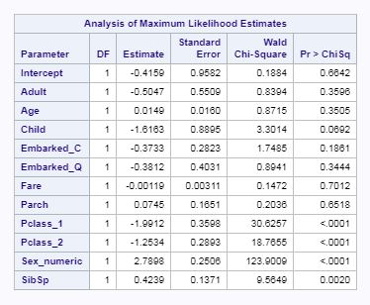
Logistic Regression-Model 1/All Variables
Using a 0.05 threshold, only Pclass_1, Pclass_2, Sex_numeric, and SipSp are relevant and less than threshold according to Pr > ChiSq in model one. Model two includes the variable Child since it shows to be slightly above the 0.05 threshold.

Slide 16
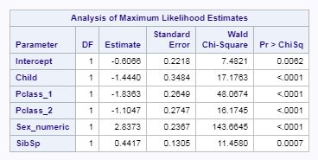
Logistic Regression-Model 2/Select Variables
Only five significant variables from model one all well below the threshold of 0.05 indicating significant variables to use in test set.

Slide 17

Coefficient & Intercept Estimate Equation
Logistic equation-log( p / (1-p) ) = mx +c (Formula to force the outcome value of p to be between 0 and 1.
log(p/(1-p)) = -0.60656 + (-1.44404*Child) + (-1.83631*Pclass_1) + (-1.10466*Pclass_2)+(2.83730*Sex_numeric)+(0.44172*SibSp)

Slide 18
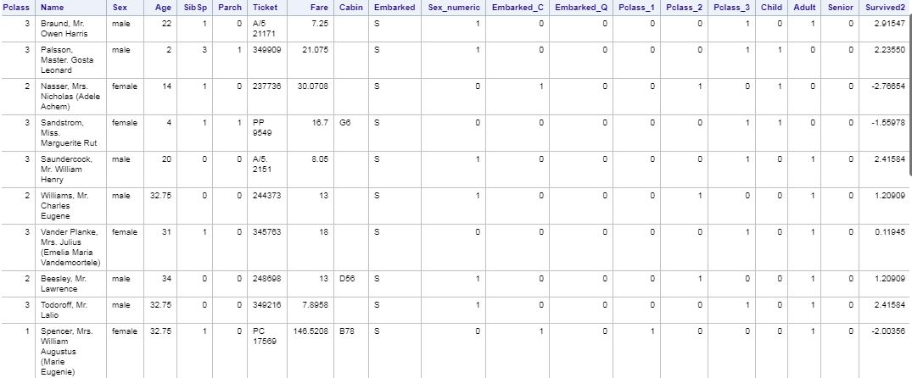
Analytical Findings/Insights
Log odds output using model two test set

Slide 19
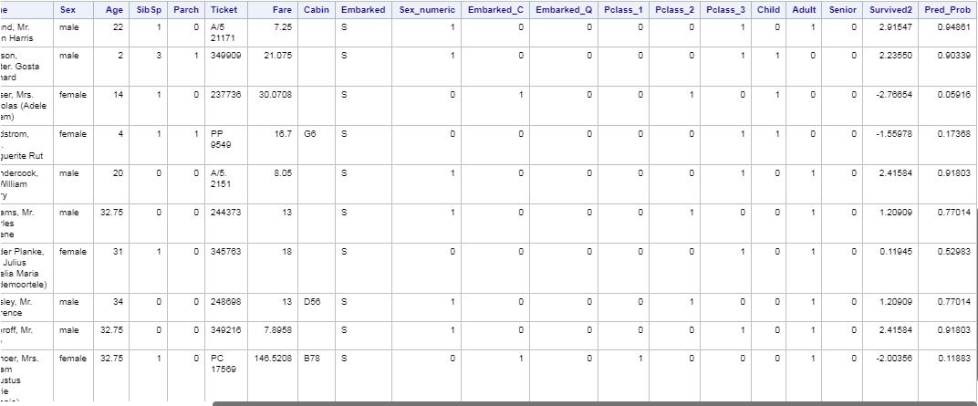
Analytical Findings/Insights Cont.
Final Probabilities output using model two test set

Slide 20
Analytical Findings/Insights Cont.
We now have the survival probability (Pred_Prob) variable calculated to see how well our model predicts passengers who survived or the ones who did not.
A table using variables “PassengerId, Survived, and Pred_Prob” will be created on the next slide in order to develop a correlation matrix based on a variety of thresholds. (Note: Only a screenshot of 22 observations will be presented on slide. 268 observations in table total.)

Slide 21
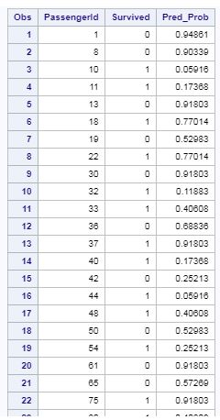
Analytical Findings/Insights Cont.

Slide 22
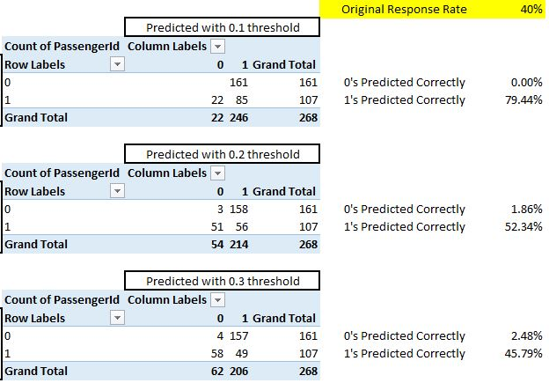
Correlation Matrix

Slide 23
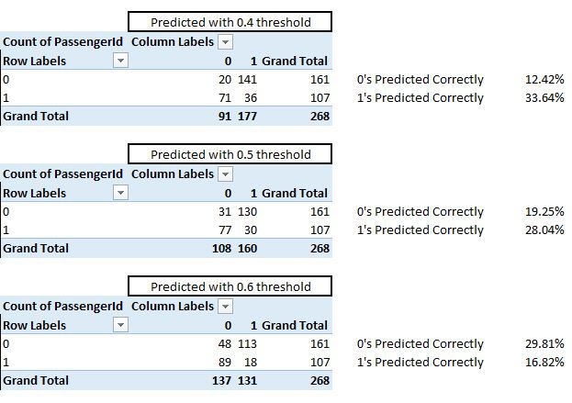
Correlation Matrix Cont.

Slide 24
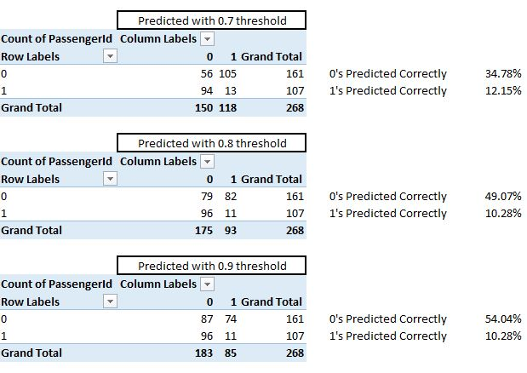
Correlation Matrix Cont.

Slide 25
Correlation Matrix Cont.
0.1 Threshold indicates a strong correlation with (1) survived at a 79.44% and 0% of (0) non-survival. 0.2 Threshold indicates a fairly strong correlation with (1) survived at a 52.34% and a 1.86% of (0) non survival. The pattern as the threshold increases continues to decrease in correlation (1) survived and increase (0) non survival. The five variables chosen with the smaller the threshold seem to be a good indicator of which passengers survived.

Slide 26
Conclusions
Passenger Class (Pclass_1 & Pclass_2), Child, and Sex (Sex_numeric) are all strong correlating variables that indicate a strong case for survival.
The saying “Women and children first” does seem to hold true based on the insights discovered in the data set.
Siblings and Spouses (SibSp) variable is significant as well with many siblings (particularly female) and spouses being overly crowded in life boats.
I predict not all siblings were female as the data does not portray the cowards fleeing to lifeboats with the women and children.

